Slide 1
Dispatch Radio 2021
2021 Updates
2021 Operations
Why Radio?
Conclusion

Slide 2
2021 Updates
DOF Frequency Guide Book will be out soon.
New and useful info:
General Layout with AFS/SMJ cheat sheet in book
Notice Dispatch centers as much as practical
Cheat sheets included for Radios, Aircraft Lineup, AM, Using Statewide Interop Zones, Iridium Radios

Slide 3
2021 Updates
DOF Repeaters are all Digital now other than the ones in Southwest. Beaver Creek, DOT Lake, and Bradley new for this year.
Iridium Radio Push to Talk in both NFDC and Mat-Su Consoles
Southwest ongoing projects

Slide 4
2021 Operations
DOF Uses Motorola MCC 7500e Radio Consoles at Fairbanks, Palmer, and Soldotna or NFDC, Mat-Su, KIDC respectively
Telex consoles are at McGrath and Copper River
State radio system ALMR, Our own repeaters. Pre-set shared IA Tac and air/ground channels
Iriduim Radios for out of coverage area’s

Slide 5
2021 Operations
DOF Extended Attack Equipment that requires a call to Commo, ordered through NFDC 907-451-2810:
Repeaters/ 4312 Command/DOF or AFS…
Cross links not in catalog
RapidComm’s
Sat Radio’s

Slide 6
Why Radio?
Question in this day in age that comes up in many forms:
Your having issues with your radio? Just call or text.
Can we just order some sort of cell booster, I would rather just call.
Radio seems so formal?
It just doesn’t work? Maybe Apple can make a radio

Slide 7
Why Radio?
What is the answer to that? Thoughts?
Coverage?
Saying use a cell phone rather than a radio built for response is like saying lets just buy a pickup truck and garden hose at Walmart or Freds. We don’t need special tools, right?
Only real simple solution to direct commo, meaning person to person.
Multiple people can hear at once, Situational Awareness
Lots of funding dedicated to a separate wide area system that does not depend on commercial vendors
Tool in the toolbox, training curve very high in this tech rich environment.

Slide 8
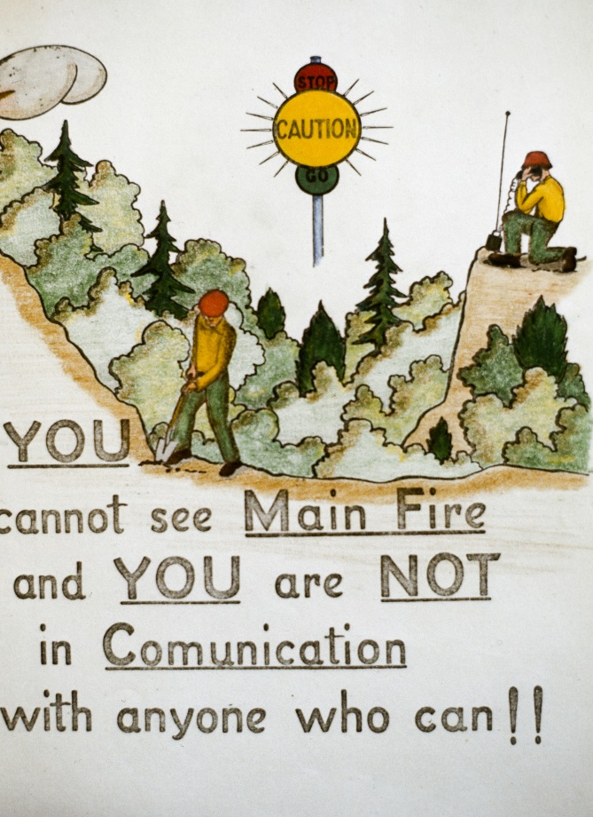
Concluding Thoughts & Questions
Duty Phone: 907-451-2810
Skinner Cell: 907-717-7286
QUESTIONS????

